Slide 1
CARD LOGISTICS
INVESTOR PRESENTATION

Slide 2
About Card Logistics
Card Logistics (CLI) is poised to become a leading provider of multi-use Smart Cards, Secured Identity Solutions, portable storage services for the healthcare, government, and entertainment sectors, and specialty card readers.
Shaping the future:
We will shape the future technology of healthcare record management, electronic medical records and secure identity management, and the management of hospitality/entertainment through innovation, technical leadership and customer centric solutions.
Innovation First:
Card Logistics has a simple philosophy: “Innovate First.” We will deliver innovative solutions in our thinking, products and services.
Customer Centric Solutions:
Card Logistics has established design, manufacturing, distribution, and service networks. Working closely with our technology suppliers, Card Logistics achieves reduced time-to-market for new products and services specifically tuned for client applications.

Slide 3
Card Logistics Management Team
William Page: inventor of the eLife Card™ System and CasinoPass™ hardware and software using advanced Smart Card Technology, and holds multiple US Patents in this technology. Prior to Card Logistics, Mr. Page served as independent consulting engineer on DOD projects such as the NMCI (47B) project using Smart Card Software and Hardware for US military bases. He was Project Manager for numerous NSA/CIA Smart Card efforts, and has over 30 years of technology experience, including Motorola AIEG, Ford Motor Company, and IBM Global Systems. The IP Development for Card Logistics was founded on this experience and research, with professional IT and engineering background that included:
Healthcare IT (Hospitals, EMS, Fire, Police) Management Consulting
NOC Systems Hardware & Software Design Engineering
Large Enterprises Applications Sales and Marketing
Wireless, Microwave, SAT Technical Support
Smart Cards, RFID, LAN / WAN Design Customer Service/Training

Slide 4
Card Logistics Management Team
Joe Fasulo: has over 35 years experience in the design and management of mission-critical Information Technology Systems, including LAN/WAN architectures, Life Safety Systems, Building Automation Systems, and wireline/wireless topologies to support these applications. He has credentials in software design and development, specifically: Simulation Systems, DataWarehousing, Decision Analysis, and E-business, and delivered successful IT hardware design and integration for enterprise applications and supporting infrastructures. He has developed business solutions utilizing advanced Smart Card Technology since 2001
Mr. Fasulo held successful Senior Project Management posts with NASA, The White House, Department of Energy, and other government agencies. He provides consulting services to public institutions in the application and integration of information systems technology. He represented BICSI and TIA in Caribbean markets, was frequently requested as speaker for global telecommunication conferences, and a recognized innovator for infrastructure design. Mr. Fasulo holds numerous industry accreditations.

Slide 5
Smart Card Markets
Smart Card Technology represented $15B in global revenues in 2012
Smart Card global revenues estimated to exceed $39B US in 2014
Healthcare Smart Card Applications represent the greatest growth:
World Bank issuing $10B to implement EHR technology solutions
India selecting 3 Smart Card providers for their entire population
Saudi Arabia funding $100B for Healthcare Technology in 2013
Countries upgrading EHR Technology: Australia, Brazil, Canada, France, Germany, Mexico, South Africa, U.A.E, United Kingdom
Budgets for these multi-year projects range from $2.0B to $60B
Entertainment Industry’s CRM interest is driving Smart Card Growth
Loyalty Cards provide significant revenue increase for Casinos
Smart Card Use for Gaming minimizes fraud and revenue loss
Annual License Fees provide significant revenue at low overhead.

Slide 6
Global EHR Development & Opportunity
“This is the last industry (EHR) to move off of paper...we’re on the front end of this movement, which likely will be a mega-trend for at least the next 10 or 15 years. ...we’re seeing substantial opportunities across the globe.”
Ivo Nelson, healthcare industry leader, Global and Americas
for IBM Business Consulting Services
“Survey work completed by Bain among provider and payer organizations indicates that of the most important IT applications under development, EHR now ranks as number one.”
David Bellaire, a partner in Bain & Company’s
worldwide healthcare practice
“Most industrialized countries have recognized the need to implement electronic health record solutions quickly to improve the quality and safety of patient care.”
Richard Alverez, CEO of Canada Health Infoway, a not-for-profit
Government Healthcare Consortium

Slide 7
Information Management Issues in Healthcare
The paper-based and fragmented international healthcare system, as documented by the Institute of Medicine (IOM) and others, is broken.
Medical errors due to missing health records or inadequate data kills patients.
Lack of up-to-date and available medical records increases healthcare costs due to the duplication and/or initiation of unnecessary procedures.
Portable/secure data storage and electronic connectivity can transform the healthcare system to better meet the needs of patients and their families.
The key to the necessary transformation in healthcare is putting patients’ personal information under their control, and then providing often-missing medical details into the hands of their doctors (e.g., recent procedures, recent diagnoses, and the medications they are actually taking).
Portable Electronic Health Records (EHRs) can play an critical role in bridging the medical information gap that too often exists between people and the health professionals who serve them.

Slide 8
Card Logistics – Healthcare Solution
Present
Future
Insurance
Patient
?
Hospital
Identification
Insurance
Clinical
?
Pharmacy
Patient
ER
eLife Card™
System
Physician
?
Hospital
Pharmacy
Clinic
Employer
?
Clinic
Nurse
Physician
Nurse
Employer
Islands of Information
Linear Approach
Collaborative Personal Health Record

Slide 9
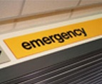
Card Logistics - System Architecture
eLife Card – The System
The eLife Card system adheres to all encryption and security requirements mandated by the government and organizations such as HIPAA. Data is transferred only over secured SSL/MQ connections via encrypted XML files.
Smart Card Reader
HOSPITAL AND
EMERGENCY
ROOM
Database Access
INITIAL
MEMBER
INPUT
PHYSICIAN AND
PHARMACY INPUT
Notes:
9

Slide 10
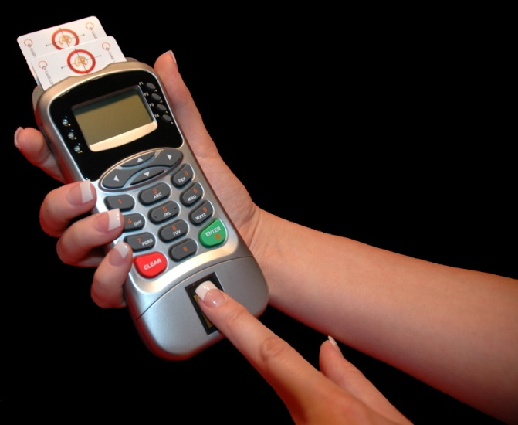
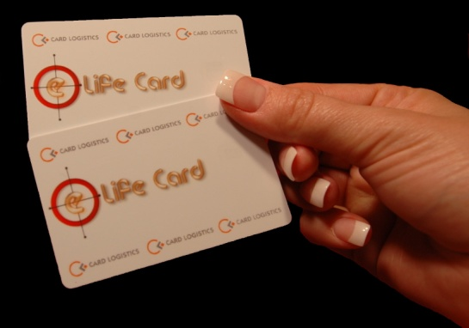
Card Logistics Proprietary Systems
$5.0M+ has been invested in the development of the eLife Card® and CasinoPass® Smart Card architecture and systems hardware.
Proprietary CL chip is ready for production in significant quantities.
eLife Card® Application Software is 95% complete, with integration of the new Web-Portal Back Office Software scheduled for 2Q 2015.
3rd Generation Dual-Slot Reader (w/Biometrics) ready for production, with CL’s selected manufacturer now prepared to produce and deliver in significant quantities. 4th Generation design ready to prototype.
Updated Mag-Smart™ reader design complete and ready to prototype.

Slide 11
CasinoPass™ System Solutions
CasinoPass® works directly with Slot Machines and other gaming machines, as well as the interface with CL’s Mag-Smart™ reader.
Multi-Application Debit, Loyalty Points and e-Purse, as well as Special Events, Room Key, Dining, Shopping and ATM Access.
Benefits are in Cash Handling, debited electronically using the integrated Financial Banking Chip, with Winnings stored on card electronically or deposited directly into Card Holder’s Bank Account.
Prevents the Counterfeiting Dilemma with existing MagStripe cards.
Casino Owners will pay an annual license fee to CL based a percentage of revenues, and purchase total of cards required.
Potential Market - 68 Countries currently allow for the operation of Casinos and Casino Resorts, with over 20,000 facilities, ranging in revenues from $1M Weekly to over $20M Nightly. Global market for the CasinoPass® Patent could exceed $2.0B US annually by 2015.

Slide 12
Marketing Cost-Effective Technology
The eLife Card® will be the most comprehensive medical and secure data identification card ever introduced to the public. The card is both a life-saving tool and an efficient multi-information storage vehicle for permanent use by the individual card holder.
The eLife Card® returns a short-term payback to the medical records client and then provides a platform for phased implementation of other applications: Access, Financial, Identity, Immigration, and Transport.
The eLife Card® exclusive “chip” has been adapted to a SIM Card implementation, for Cell Phone and other Mobile Applications, allowing for unique customer solutions.
The eLife Card® companion back-office Web-Portal Software System will provide a complete medical records management solution in any language (available in 2Q 2015).

Slide 13
Marketing Cost-Effective Technology - cont’d
The CasinoPass® is built on a similar hardware and operating system platform as the eLife Card®, thus providing a short-term solution for the Casino Owners’ existing Loyalty Card demands, with the built-in ability to develop into the Casino’s Multi-use Smart Card.
The CasinoPass® provides the basic internal architecture for a general-use hospitality and/or retail loyalty cards, with the built-in capability to function as a client-specific Financial Transaction Card.
The Mag-Smart® reader and Dual-Slot Biometrics reader provide a flexible resource for custom designed solutions, using both CL’s Smart Cards and various third-party system integration requirements.
CL’s Advanced Security Encryption Algorithms, along with the integration of our unique hardware interfaces, enables the design and implementation of new portable and secure data transfer applications.

Slide 14
Future Directions of Card Logistics
Design and Implementation of New Products
Security & Encryption Architecture Integration
Advanced Card Reader/Tablet Integration
Proximity Locator System Implementation (PLS™)
Acquisition of Complimentary Technologies
Wireless / RFID Interfaces
Embedded Software Applications
Back-Office Software Applications
Funding of Infrastructure Development
Systems synergistic to CLI Product Implementation

